Slide 1
Creating a New Role: Head of Net Zero Delivery & Innovation

Slide 2
Presented by:
SCOTT DONACHIE
CEO Companies for Net Zero

Slide 3
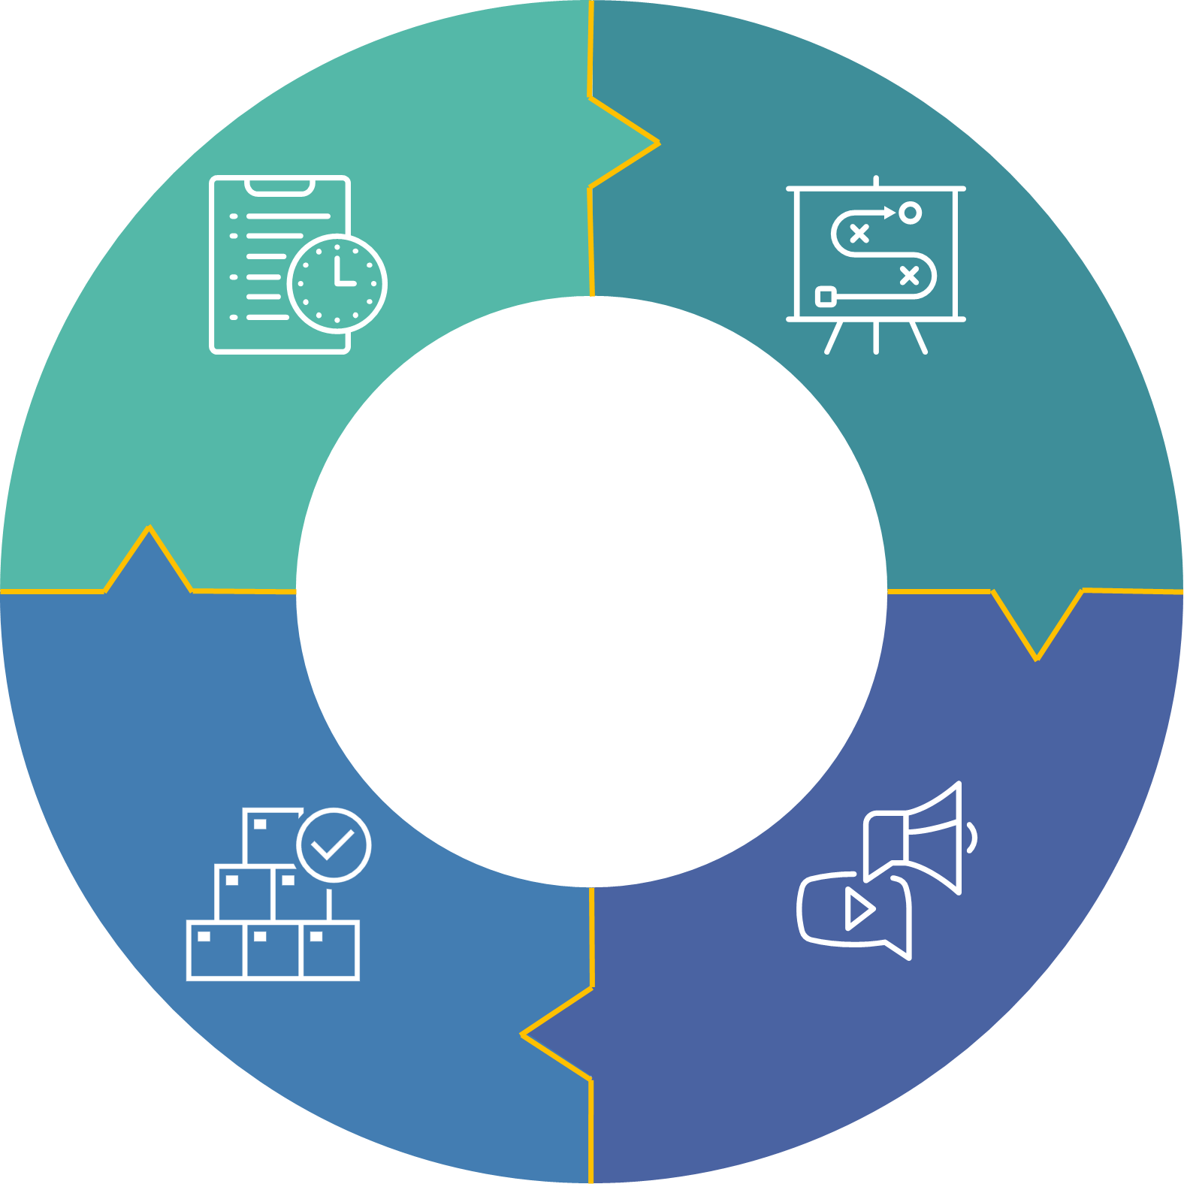
The Cycle to Net Zero
MEASURE
PLAN
DELIVER
ENGAGE

Slide 4
Assessing Novel Climate Technology
Head of Net Zero Delivery & Innovation
Environmental impact
Technological maturity
Cost-effectiveness/payback
Integration & Scalability
Regulatory compliance
Competitive advantage
Ideal skill-set:
20+ years commercial/operational experience
Highly qualified (masters level e.g. MBA)
Strong internal (and external) corporate network
Ideally, a future CEO candidate
Notes:
Environmental impact: Analyze the technology's overall environmental benefits, such as reduced greenhouse gas emissions, lower waste production, or improved resource efficiency, while considering any potential negative impacts during its lifecycle.
Technological maturity: Examine the stage of development of the technology, its proven track record, and the availability of supporting data and research. Consider the risks associated with adopting early-stage or unproven technologies.
Cost-effectiveness/payback: Assess the upfront and long-term costs relative to potential savings in energy, resources, or emissions trading.
Integration & Scalability: Evaluate the technology's potential for large-scale implementation, taking into account factors such as infrastructure requirements, ease of integration with existing processes, and adaptability to different environments or industries.
Regulatory compliance: Ensure that the technology adheres to current and potential future environmental regulations and standards, reducing the risk of non-compliance and any associated penalties or reputational damage.
Competitive advantage: Assess the potential of the novel climate technology to create a competitive edge for the company, in terms of increased efficiency, reduced operational costs, improved public image, or alignment with consumer preferences for sustainability.

Slide 5
Head of Net Zero Delivery & Innovation
C-suite interface
New technology
engagement
Business segment interface: e.g. operations, legal, finance, IT, etc
Notes:
Environmental impact: Analyze the technology's overall environmental benefits, such as reduced greenhouse gas emissions, lower waste production, or improved resource efficiency, while considering any potential negative impacts during its lifecycle.
Technological maturity: Examine the stage of development of the technology, its proven track record, and the availability of supporting data and research. Consider the risks associated with adopting early-stage or unproven technologies.
Cost-effectiveness/payback: Assess the upfront and long-term costs relative to potential savings in energy, resources, or emissions trading.
Integration & Scalability: Evaluate the technology's potential for large-scale implementation, taking into account factors such as infrastructure requirements, ease of integration with existing processes, and adaptability to different environments or industries.
Regulatory compliance: Ensure that the technology adheres to current and potential future environmental regulations and standards, reducing the risk of non-compliance and any associated penalties or reputational damage.
Competitive advantage: Assess the potential of the novel climate technology to create a competitive edge for the company, in terms of increased efficiency, reduced operational costs, improved public image, or alignment with consumer preferences for sustainability.

