Slide 1
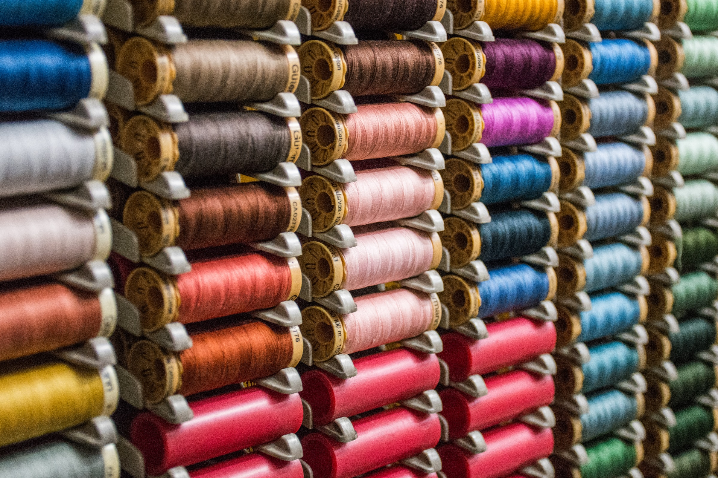
AAPN Conference - April 20, 2023
Office of Textiles and Apparel (OTEXA)
Advance the competitiveness of the U.S. man-made fiber, textile, apparel, footwear, and travel goods industries through the development and execution of international trade, investment policies, and promotion strategies
Jennifer Knight
Deputy Assistant Secretary
For: Textiles, Consumer Goods and Materials
U.S. Department of Commerce

Slide 2
USFIA – Trade Policy Update
Agenda
Administration’s Policy Priorities
Overview of OTEXA
Textile & Apparel Industry Overview
Reshoring and Nearshoring

Slide 3
Factors Affecting Supply Chain Resiliency
COVID-19
Political Instability
Energy & Climate Change
Labor and Intellectual Property Rights
Economic Concerns
Legislation Pressure

Slide 4
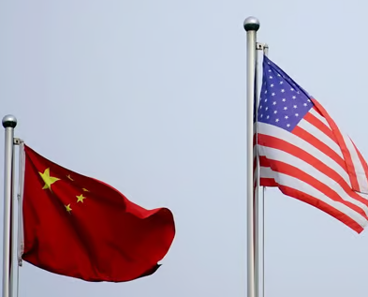
Trade Policy focused on Supply Chains and China
“U.S. Trade Representative Kathrine Tai and other Biden administration officials have said repeatedly that the administration is taking a new approach to trade and trade deals, one that prioritizes workers, the environment and resiliency”
- Inside US Trade (Feb 15, 2023
The Select Committee will focus on “…restoring supply chains and ending critical economic dependencies on China…”
-The Honerable Gina Raimondo
Secretary, U.S. Department of Commerce
“We will examine using both trade policy and our tax code to re-shore and strengthen our supply chains”
-Rep. Jason Smith (R-MO)
Chair, House W&M Committee
“The Select Committee will focus on “…restoring supply chains and ending critical economic dependencies on China…”
-Speaker Kevin McMarthy (R-CA)
Rep. Mike Gallagher (R-WI)

Slide 5
U.S. Trade Policy Overarching Strategic Goals
Advancing a Worker-Centered Trade Policy:
Rebuilding Alliances
Fully Enforce U.S. Trade Laws:
Greater focus on Labor, environment, human rights
Less emphasis on tariffs & market access
Better communication on how trade helps workers and inclusivity
Improving trade and economic relationships with other countries
Priority on Europe and Asia/Indo-Pacific, and Latin America
Building alliances to help leverage China
Monitor compliance with agreements, and use all tools to hold other countries accountable (Labor, Environment and intellectual property rights)
Ensure that China lives up to its existing trade obligations

Slide 6
U.S. Negotiations and Discussions
Acronym | Full Name | Negotiating Countries
IPEF | Indo-Pacific Economic Forum | Australia, Brunei, India, Indonesia, Japan, Korea, Malaysia, New Zealand, the Philippines, Singapore, Thailand, United States, and Vietnam
TTC | Trade and Technology Council | European Union
APEP | Americas Partnership for Economic Prosperity | Barbados, Canada, Chile, Columbia, Costa Rica, the Dominican Republic, Ecuador, Mexico, Panama, Peru, United States, and Uruguay
Taiwan | U.S.-Taiwan Initiative on 21st Century Trade | Taiwan
STIP | Strategic Trade and Investment Partnership | Kenya
WTO | World Trade Organization | All countries
Notes:
The Indo Pacific region has 60% of the world’s population and is projected to be the largest contributor to global growth over the next 30 years - which is why we need to deepen our trade partnerships there.
In Europe we’re deepening our solidarity in response to Russia’s war of aggression – helping allies meet near-term energy needs and plan for long-term energy security. Through EU-TTC, we’re also tackling next-generation challenges to align Transatlantic approaches to export controls, secure supply chains, data governance and investment security.

Slide 7
Indo-Pacific Economic Forum (IPEF) Negotiations
Trade
Supply Chains
Clean Economy
Fair Economy
“Resilient, sustainable, inclusive economic growth”
Preventing future supply chain disruptions, particularly for ‘critical sectors’
“Enhancing the use of clean energy and climate friendly technologies”
Improving the ‘level playing field’ for all market participants
Notes:
In IPEF, we partnering with 13 countries with goal of increasing shared prosperity, shaping technological innovation and tackling economic challenges and increasing trade and investment.
Essentially this is the Administration’s effort to reassert U.S. economic leadership in the region.
DOC is leading three pillars….
Impossible to discuss the future of this region without addressing the challenges posted by the PRC – and ITA’s role in addressing them.
In half century of relations, the U.S. China relationship has become the world’s most consequential. It is now our third largest export market and our private sector has helped to shape that development.
Despite hopes that China would embrace political and economic reform, President Xi and the Chinese Communist Party have taken a different path – increasing the role of the state in society and the economy, constraining the free flow of capital and information, fusing economic and technology policies with military ambitions, and deploying coercive economic policies against both countries and non-Chinese companies.
SGR and the Administration – INVEST, ALIGN and COMPETE
Moderninizing our approach to supply chain resiliency, export controls and inbound and outbound investment.
Let me be clear – we do not seek to decouple from the Chinese economy BUT
Our number one priority is protecting and advancing our economic and national security interests.

Slide 8
Who Are We?
International Trade Administration
The mission of ITA is to create prosperity by strengthening the international competitiveness of U.S. industry, promoting trade and investment, and ensuring fair trade and compliance with trade laws and agreements.
Enforcement & Compliance
Industry & Analysis
Global Markets
Textiles, Consumer Goods, & Materials
OTEXA
Notes:
Trade Policy Administration
Support to the U.S. Trade Representative in Free Trade Agreement negotiations on the Textile and Apparel Chapter. We provide comprehensive sectoral analyses and product-specific advice for trade policy development and implementation.
Statutory provisions in Free Trade Agreements & Preference Programs
Miscellaneous Tariff Bills (MTB)
Foreign Trade Zones
Support SME exporters and B2B matchmaking
China Trade issues (301 Tariffs, Forced Labor)
Industry Trade Advisory Committee on Textiles and Clothing (ITAC – 12)
Trade Data and Analysis
Promote Reshoring and Nearshoring Initiatives
Supply Chain Resiliency
Made in USA

Slide 9
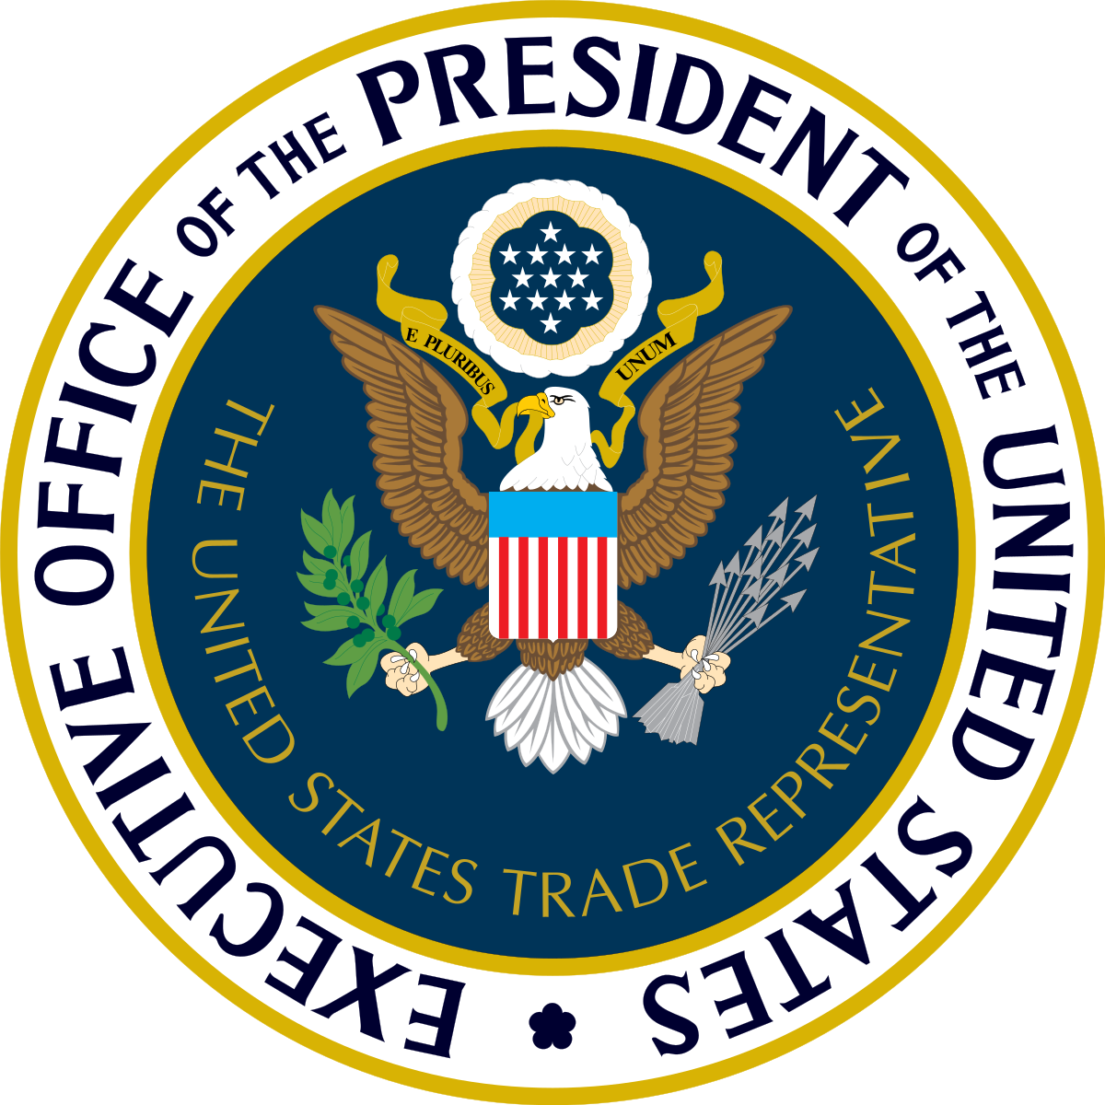
Committee for the Implementation of Textile Agreements
CITA
Responsibilities
Interagency committee chaired by the Department of Commerce
Implements textile and apparel provisions of Free Trade Agreements (FTAs) and preference programs. (AGOA, CBTP, Haiti, Nepal)
Administers and/or manages FTA commercial availability provisions “Short-Supply” for CAFTA-DR, Colombia, Panama, Peru.
Notes:
Established in 1972, CITA is an interagency committee chaired by the Department of Commerce, includes the Office of the U.S. Trade Representative (USTR), Labor, State, and Treasury
Implements textile and apparel provisions of Free Trade Agreements (FTAs) and unilateral preference programs (e.g., the African Growth and Opportunity Act, the Caribbean Basin Trade Partnership Act, and Haiti)
Administers FTA commercial availability (“short supply”) provisions for CAFTA-DR, Colombia, Panama, and Peru
Administers FTA textile and apparel safeguard actions

Slide 10
U.S. Laws and Legislation
Forced
Labor
Uyghur Forced Labor Prevention Act (UFLPA) - 2021
Effective June 21, 2022, the UFLPA imposes a rebuttable presumption that imports of goods made in whole or in part in the Xinjiang Uyghur Autonomous Region of China, and/or by certain entities are made with forced labor.
The Forced Labor Enforcement Task Force (FLETF) – 2020
Interagency team responsible for monitoring U.S. enforcement of the prohibition on importing goods produced with forced labor.
Notes:
The Uyghur Forced Labor Prevention Act (UFLPA) was signed into law by President Biden in December 2021 and became effective in June, 2022. It establishes a rebuttable presumption that the importation of any goods made in whole or in part in the Xinjiang Uyghur Autonomous Region of China, and/or produced by certain entities, are made by forced labor, and therefore prohibited from being imported into the United States.
The rebuttable presumption, which is implemented by CBP at the time of import, also applies to downstream products that incorporate goods produced in the Xinjiang region as inputs, regardless of where the products are produced. What this means is that this applies to goods produced in China outside of Xinjiang as well as goods produced in third countries or shipped through third countries. DHS/CBP maintains information of specific entities on its UFLPA Entity List. DHS enforces the prohibition through trade enforcement at the border and associated criminal investigative activities, which are overseen and principally led by CBP and the U.S. Immigration and Customs Enforcement (ICE) Homeland Security Investigations (HSI).
The Forced Labor Enforcement Task Force (FLETF) is an interagency task force responsible for monitoring U.S. enforcement of the prohibition on importing goods produced with forced labor globally. Chaired by DHS FLETF other member agencies include USTR and the Departments of Labor, State, Treasury, Justice and Commerce. The Departments of Energy and Agriculture, USAID, and the National Security Council participate as observer agencies.

Slide 11
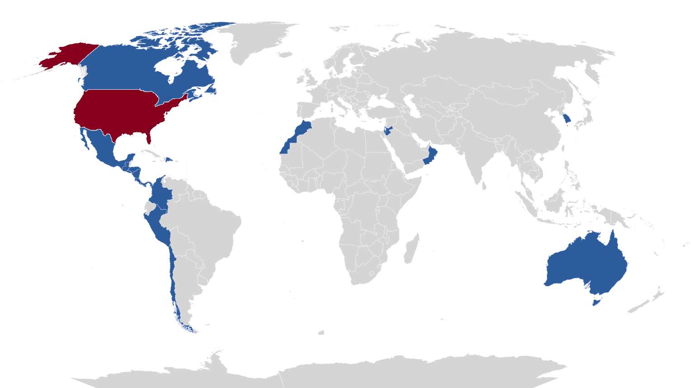
Free Trade Agreements
Background
USMCA
Canada & Mexico
CAFTA-DR
Costa Rica, Dominican Republic, El Salvador, Guatemala, Honduras, Nicaragua
Western Hemisphere
Chile, Colombia, Panama, Peru
Rest of the World
Australia, Bahrain, Israel, Jordan, Morocco, Oman, Singapore, South Korea
Notes:
United States has free trade agreements (FTA’s) in force with 20 countries and four trade preference programs for select developing countries
12 in the Western Hemisphere
8 FTA’s elsewhere round the world include Israel, Jordan, Australia, Singapore, Bahrain, Morocco, Oman, South Korea
US FTA’s include a separate textile and apparel chapter, reciprocal market access, yarn-forward rule of origin with certain flexibilities, safeguard mechanism, customs cooperation, other flexibilities including cut sew
The trade preference programs include the African Growth and Opportunity Act, Caribbean Basin Trade Partnership Ac, Haitian Hemispheric Opportunity through Partnership for Encouragement Act and the Nepal Trade Preference Program.

Slide 12
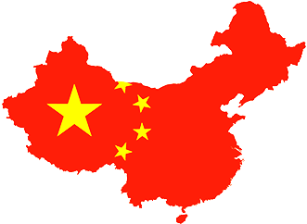
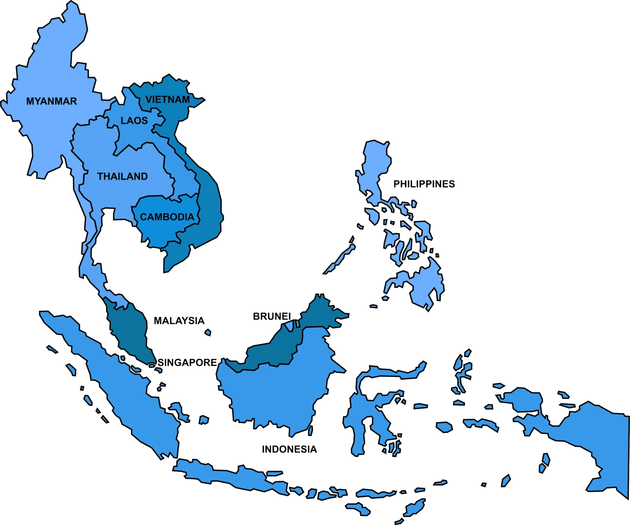
Leading Suppliers to the U.S.
% Change of Imports of Textiles & Apparel from 2020 - 2022
Overall Imports grew by 24%
$120B in 2020
$149B in 2022
-14%
China
+45%
+41%
+39%
ASEAN
European Union
FTA Partner Countries

Slide 13
FTA Textiles & Apparel Import Data
16.7% or $24.9B of textiles & apparel imports from FTA partners
14.6% of imports of textiles & apparel from Western Hemisphere FTA partners
7.4% from CAFTA-DR
5.5% from USMCA
0.7% from Peru
0.3% from Colombia
Source: Office of Textiles and Apparel, Trade Balance Report
Notes:
72.5 % of export of U.S. textile and apparel goes to FTA partners
68.9% to WH FTA partners
51.3% to USMCA
16.5% of imports of textile and apparel from FTA partners
18.6% of imports of apparel from FTA partners
16.0% of imports of apparel from WH FTA partners
10.6% by CAFTA-DR
4.1% by USMCA
0.9% by Peru
0.4% by Colombia

Slide 14
Import Share of Textiles & Apparel
-31% Decline for China
+11% for Vietnam
+30% for India
+48% for Bangladesh
+30% for CAFTA-DR
Source: Office of Textiles and Apparel, Trade Balance Report
Notes:
We are now looking at the share of imports.
We can clearly see that from 2020 to 2022 China went from almost 40% of all imports of textiles and Apparel to just 27% percent. A decline of 31% in just two years.
Vietnam increased their market share by 11% and India and Bangladesh saw huge increases in their market share growing 30% and 47% respectively.
Increased Nearshoring to CAFTA-DR is made clear here with the region growing to have 7 and a half percent of total U.S. imports of Textiles and Apparel
Other countries not highlighted here that saw substantial growth were Indonesia, Cambodia, Pakistan and Turkey

Slide 15
Top U.S. Textile & Apparel Export Markets
% Change of Exports of Textiles & Apparel from 2020 - 2022
Overall Exports grew by 29%
$19.3B in 2020
$24.9B in 2022
-0.6%
China
+10%
+19%
+34%
ASEAN
European Union
FTA Partner Countries

Slide 16
FTA Textile and Apparel Export Data
73% of U.S. textile and apparel exports go to FTA partners
69.8% to Western Hemisphere FTA partners:
51.5% to USMCA
16.2% to CAFTA-DR
Source: Office of Textiles and Apparel, Trade Balance Report.
Notes:
73% of U.S. textile and apparel exports go to FTA partners
69.8% to Western Hemisphere FTA partners:
51.5% to USMCA
16.2% to CAFTA-DR

Slide 17
Committed Investments in the CAFTA-DR Region
Vice President’s Call to Action
Business and Investment Council
(Honduras, USA, Guatemala, El Salvador)
Textile and Apparel Investments
Textile and Apparel Investments
Parkdale | $150m | Protela | $45m
Intradeco | $100m | Columbia | $200m
Unifi | $15m | Nextil | $40m
San Mar | $500m | Target | $2.5B*
Gap | $150m |  | *Over 10 years
Elcatex (HN) | $100m
Imperialtex (GT) | $100m
TOTAL Regional Investment: $3.9 Billion
Notes:
U.S. businesses and social enterprises made commitments of over 3.9 billion in the textile and apparel sector to promote economic opportunity in Northern Central America, which helps support a broader strategy to address the root causes of migration.
The U.S. continues to engage with Central American partner countries to address trade-related issues to optimize inclusive economic opportunities; strengthen trade rules and transparency and address non-tariff trade impediments; provide capacity building in areas such as textile and apparel trade-related regulation and practice on customs, border and market access issues, including agricultural and sanitary and phytosanitary regulations, to avoid barriers to trade.
Continue to engage CAFTA-DR partners and stakeholders to identify and develop means to increase two-way trade in textiles and apparel and strengthen the North American supply chain and near-shoring to enhance formal job creation.

Slide 18
Thank You!
Jennifer Knight
Deputy Assistant Secretary
for Textiles, Consumer Goods and Materials
U.S. Department of Commerce
Jennifer.Knight@trade.gov
www.trade.gov/otexa

