Slide 1
My Marginal Costs = His %MU X His Marginal Costs
Management Matters
Barbara Mounsey Zeins
President and COO, Gerson and Gerson, Inc.
AAPN Meeting
May 2, 2011

Slide 2
Gerson and Gerson
Founded in 1937
Dresses, dresses, dresses….
Family Held
Strong culture
Early adopters until the last few years
Over 5 million dresses a year

Slide 3
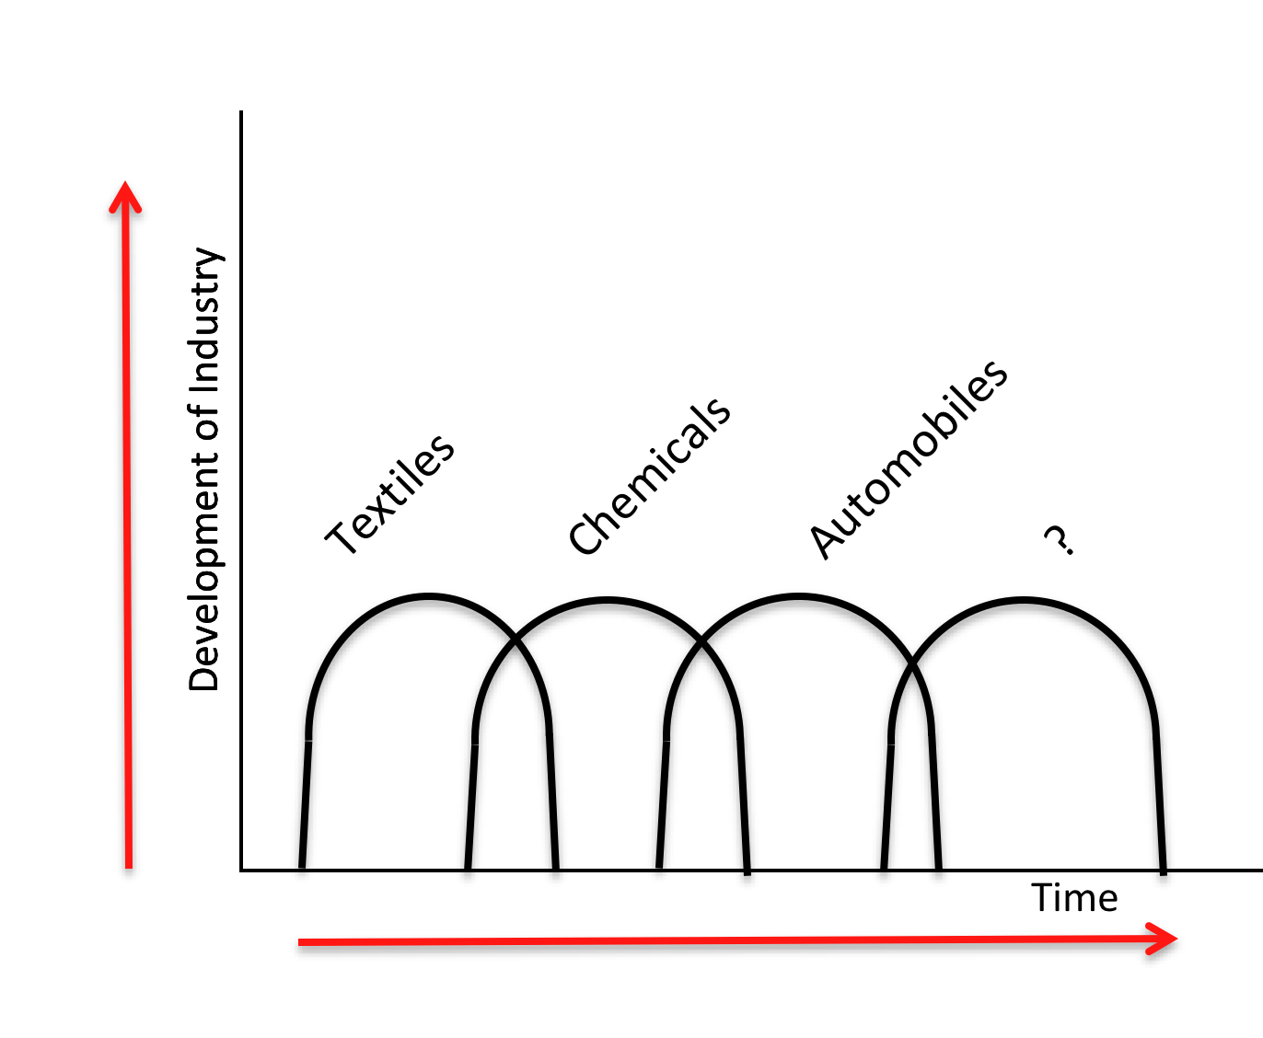
Flying Geese Theory

Slide 4
Standard Cost PLUS Accounting:
Fabric & Trim
+ Labor
+ Overhead Factor
_________
= Direct Costs
x (1-mu)
__________
= Selling Price

Slide 5
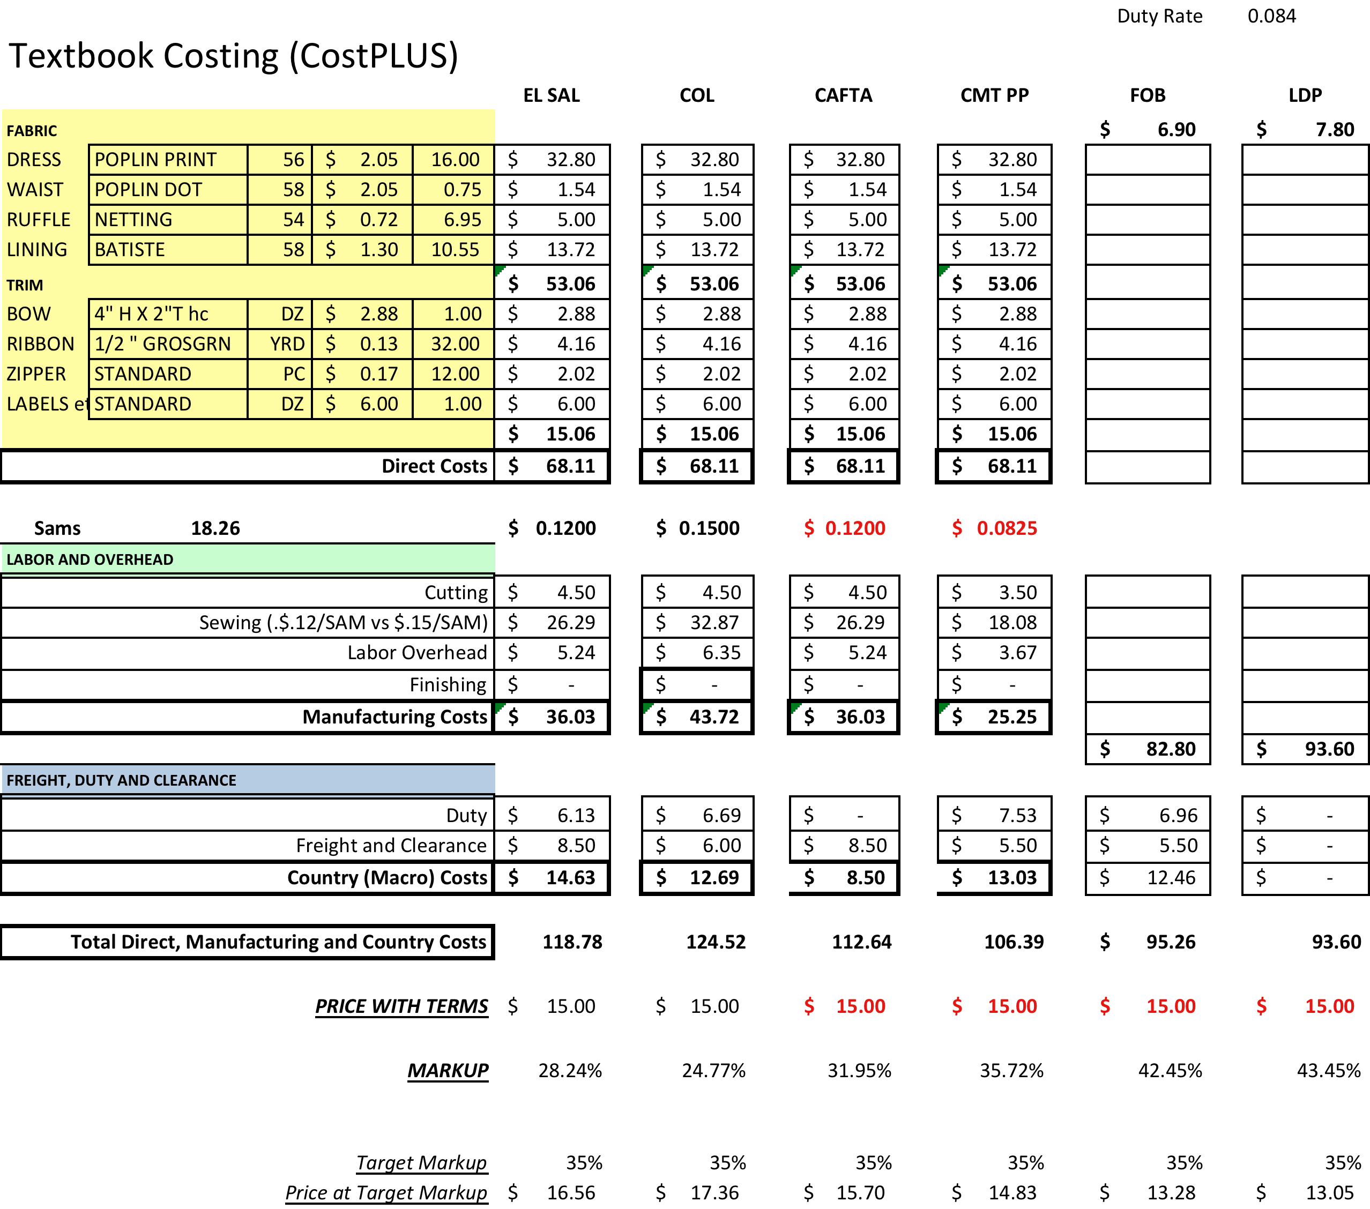
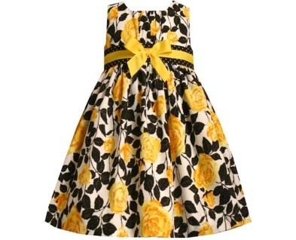

Slide 6
It is dysfunctional and destructive to optimize toward a single GM%
Ignores Differences between customers
Ignores Costs for development of capacity
Ignores Travel, Communication, QC costs
Ignores substantial “set up”
Ignores the need for “robustness” in the firm

Slide 7
Notes:
The only driver the purchasing agent has is the direct fabric and trim costs. Her options are pretty much as follows:
1 – Beat up the existing vendor
2 – Find a new, cheaper vendor
3 – Purchase in bulk
4- Buy an inferior quality good and hope it sticks

Slide 8
Purchasing Managers:
Beat up the existing vendor
Find a new vendor whose quality, reliability and delivery performance are questionable
Buy from distant suppliers especially if freight costs were not traced to styles
Added staff to travel, check quality, resolve shortages
Lost sales to damages, shortages
--Kaplan and Cooper
Cost and Effect

Slide 9
Notes:
What are his options:
1 – Bid every style out
2 – Give it to the lowest bidder

Slide 10
Product Designers and Engineers “receive faulty signals about the economics of their products”
Ignores costs of unique vs. common parts
Ignores costs of setting up new vs. using existing vendors
Ignores costs of using simple vs. complex processes
Encourages over-proliferation of products
80% or more of manufacturing costs are determined during the design phase…..”
--J E Michaels and W P Wood
Design to Cost

Slide 11
Cost Pools, Batch Sizes, Better Cost Allocations
Sourcing, negotiating, purchase and financing of goods and trims.
Patterns, grading, marking, samples
Issuing PO’s, tracking, receiving, QC-ing, distributing raw materials
Customer service level
Floor Ready, Packing, Cartons, Ticketing

Slide 12
My Marginal Costs = His %MU X His Marginal Costs
Your Price = My % MU X My Marginal Costs
BAD NEWS: Marginal Costs are going up, period.
2. GOOD NEWS: The Public Knows this. You are not alone and you cannot control it.
3. BAD NEWS: Demand may soften as a result.
4. GOOD NEWS: Manufacturers and retailers have sent each other strong pricing signals.
Notes:
The Good News

Slide 13
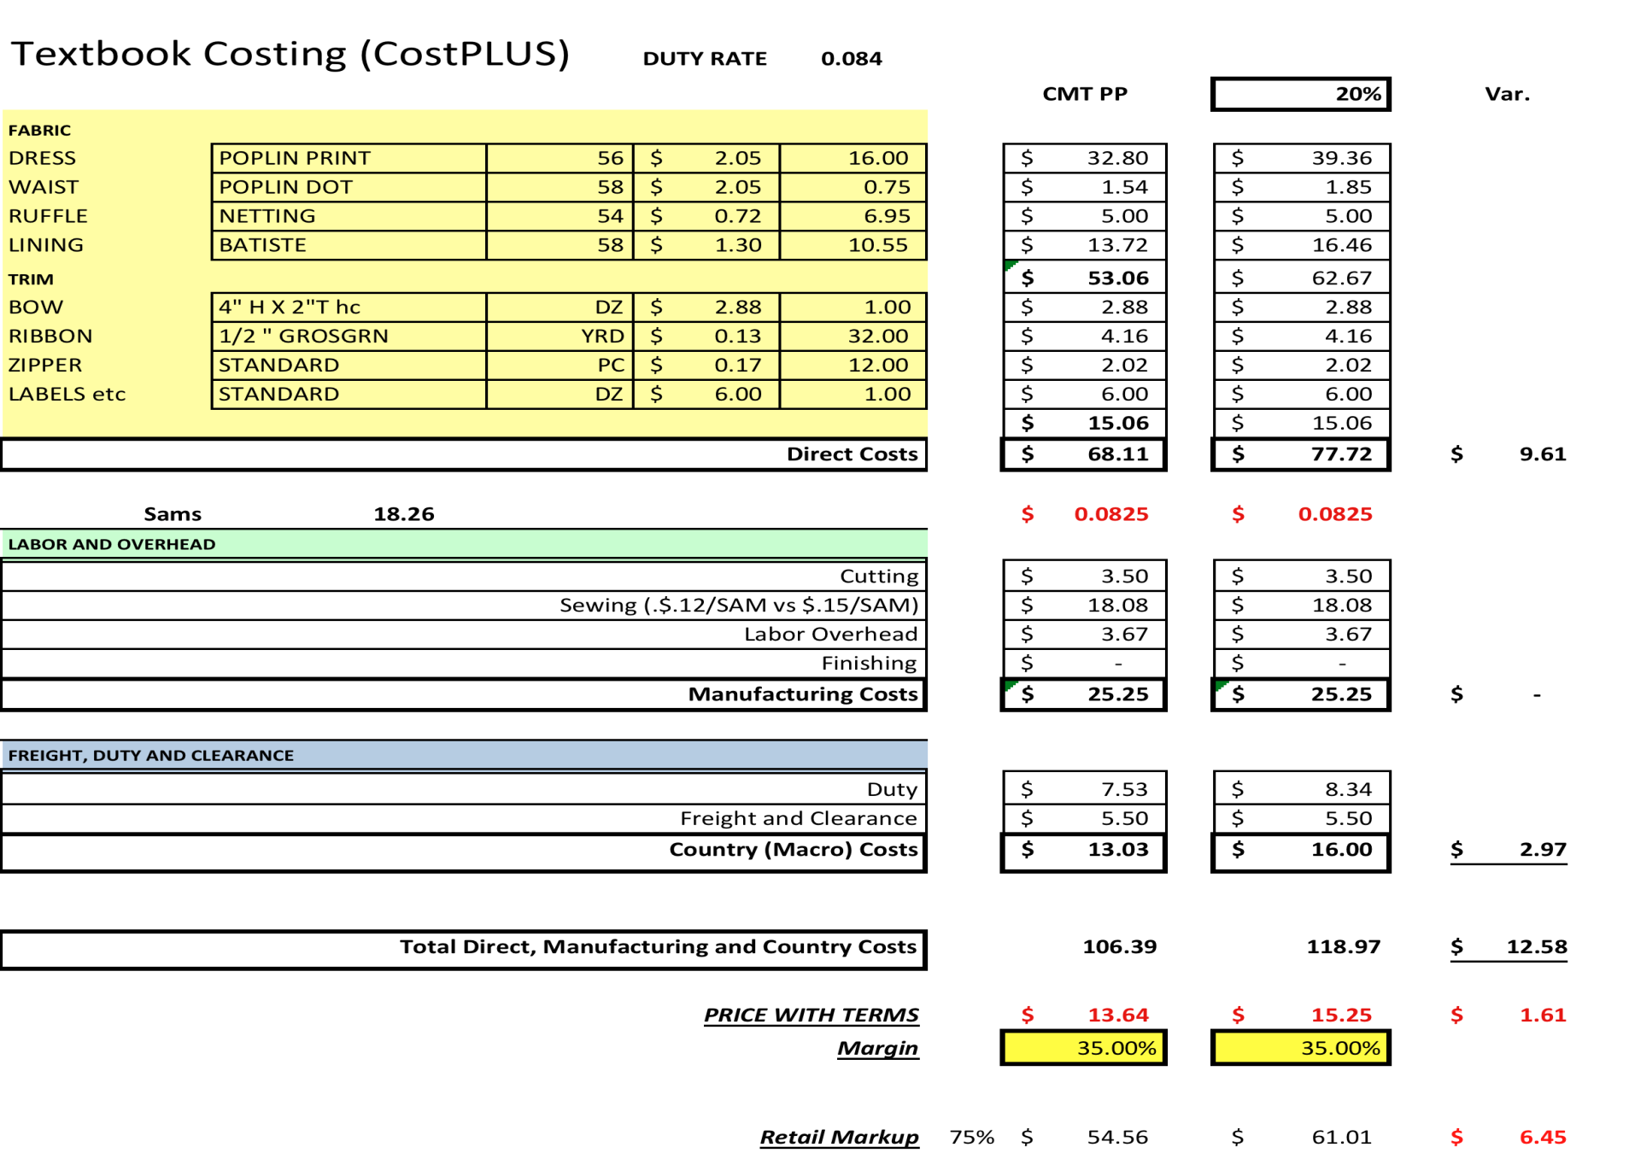
Sensitivity to a 20% increase in Fabric Price

Slide 14
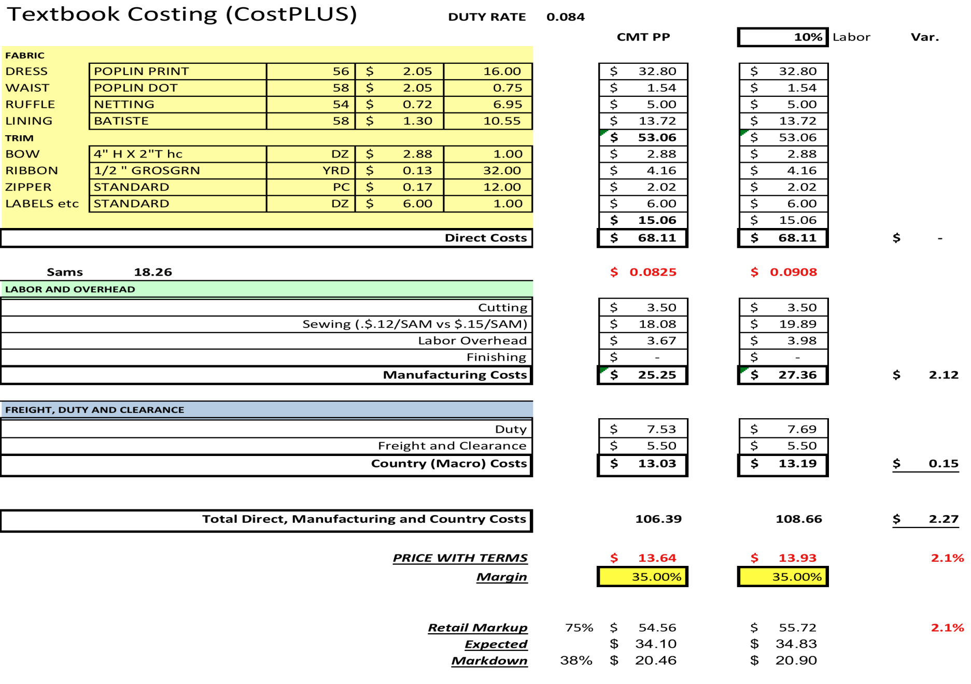
Sensitivity to a 10% increase in Labor Price

Slide 15
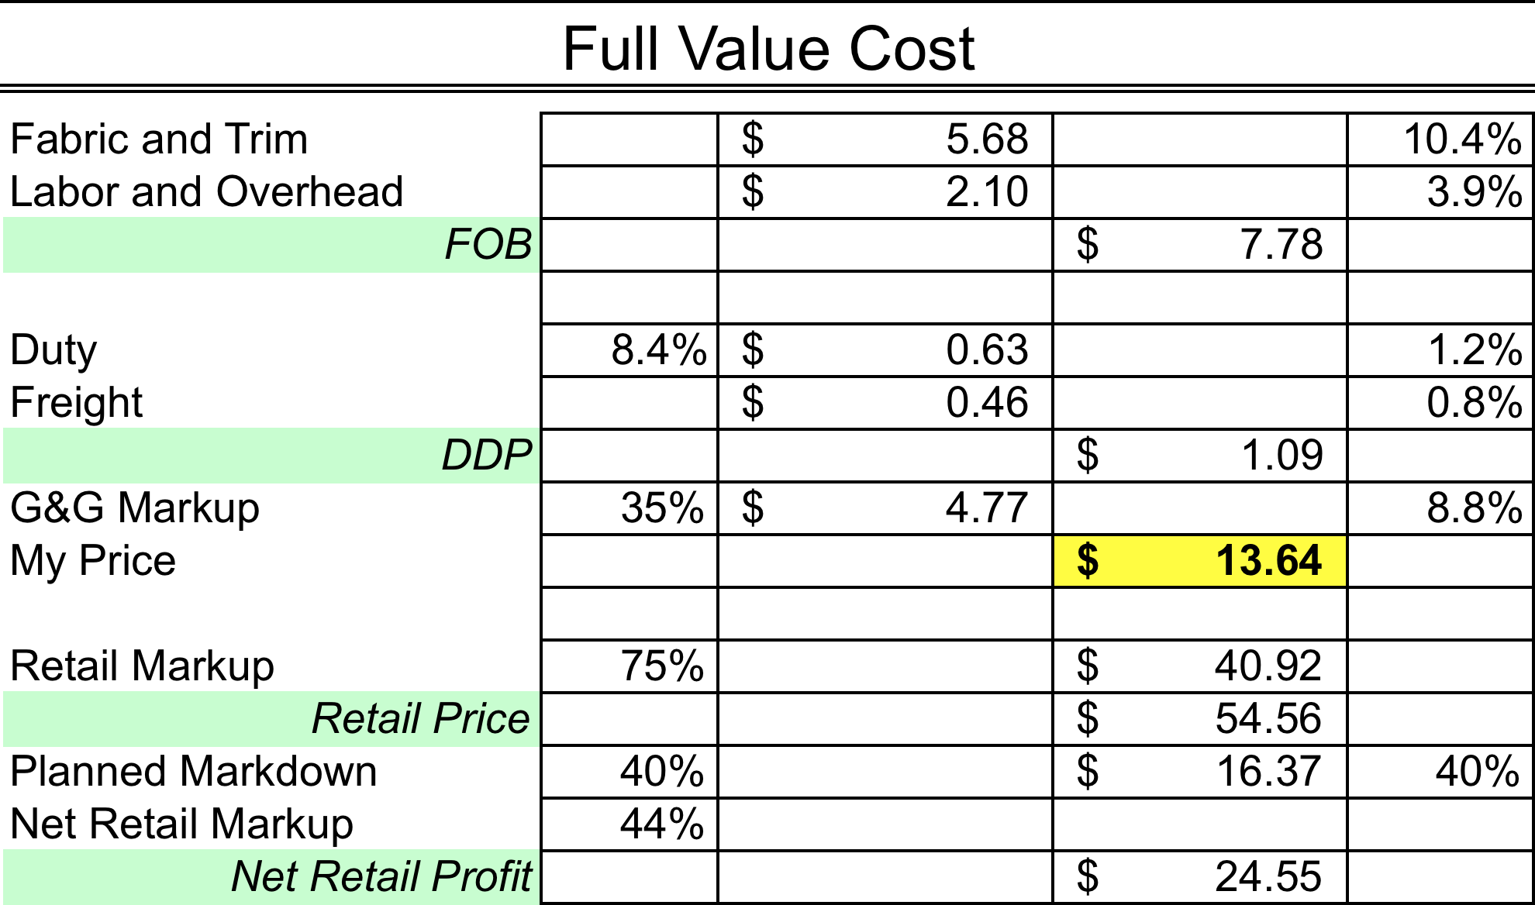
Know your sensitivity to these measures and know the sensitivity of your customers.

Slide 16
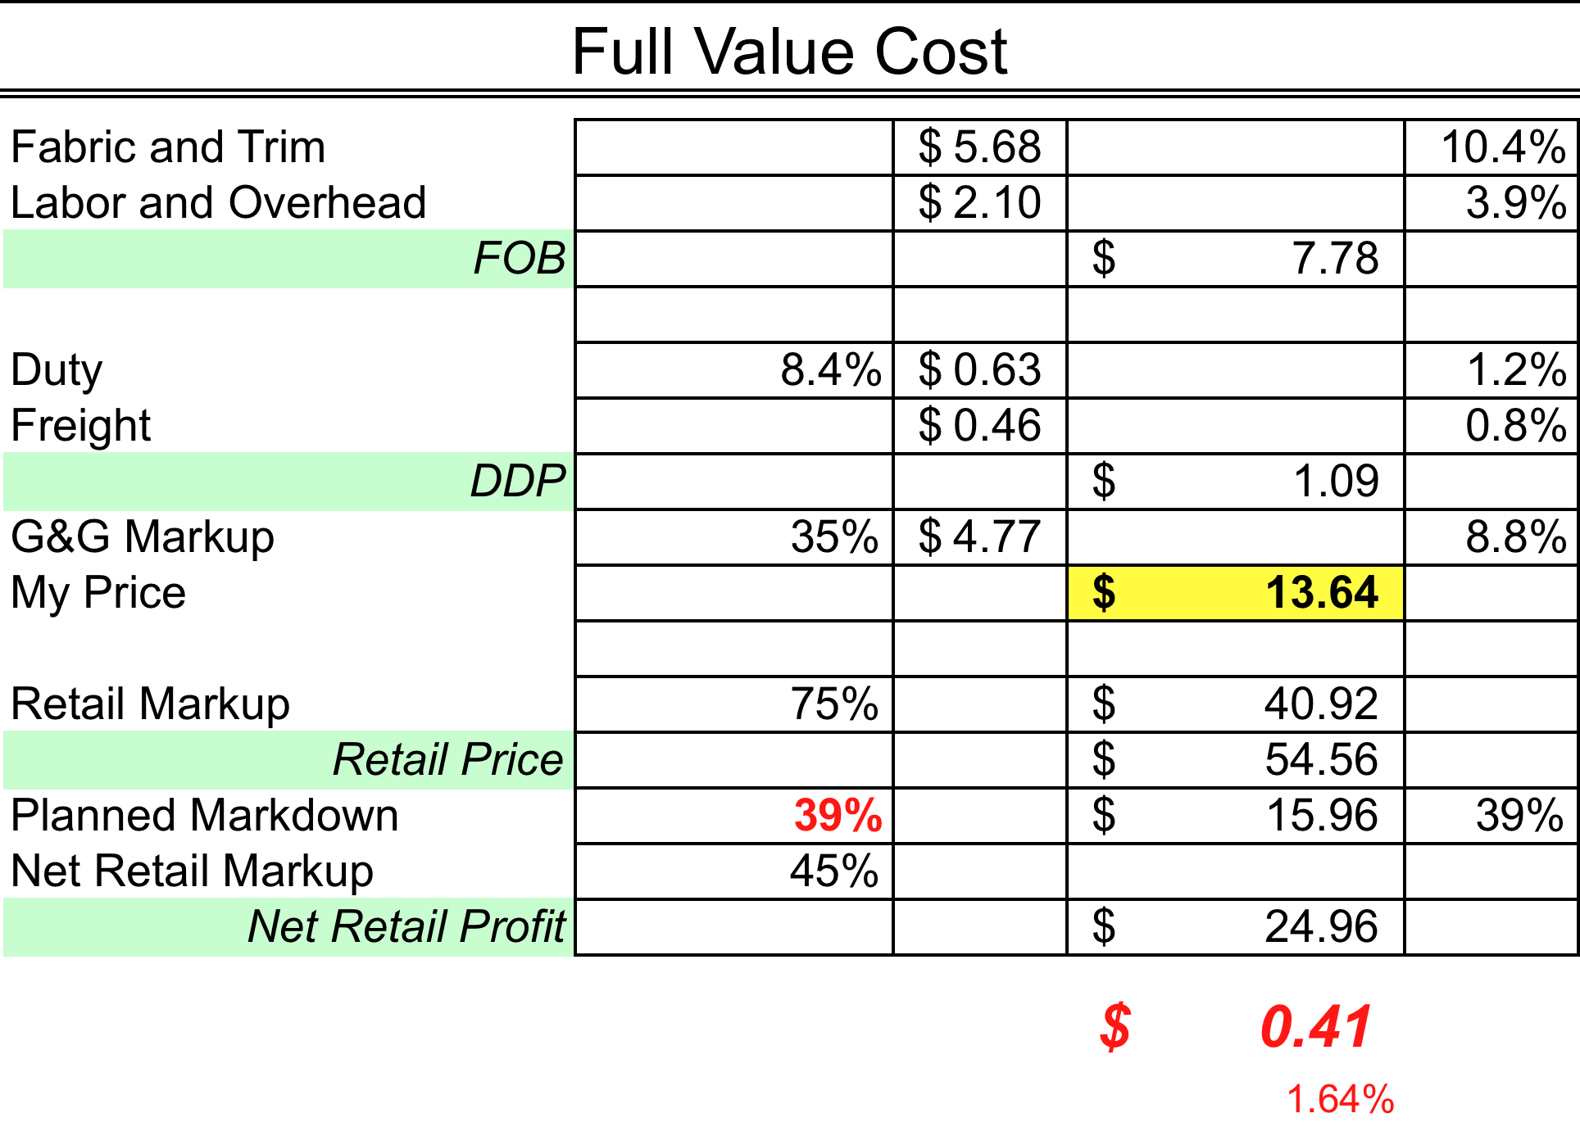
Know what a point of planned markdown is worth

Slide 17
“At the turn of the century (1900) it was crudely estimated that 90% of the people working could not do their job as well as their bosses could. Now it is estimated that 90% of people employed can do their job better than their boss can.”
-Russell Ackoff
lifelong critic of the modern organizational form
1992, in a conversation with W. Edwards Deming

Slide 18
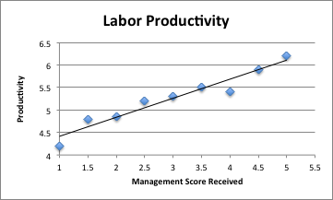
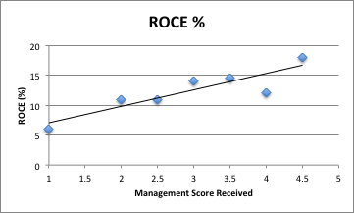
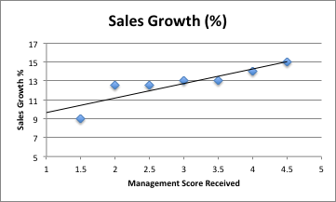
“Management Practice and Productivity: Why The Matter”
www.stanford.edu/~nbloom/ManagementReport.pdf

Slide 19
”It is not necessary to change, survival is not mandatory."
--W. Edwards Deming American Statistician, Consultant and Professor
Credited with teaching management in Japan in the 50’s to improve quality, testing and sales

